Slide 1
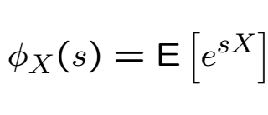
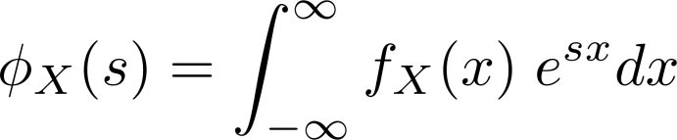
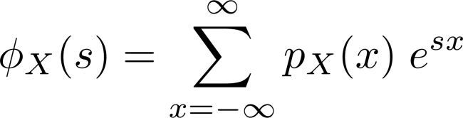
Moment Generating Function
The MGF of a RV $X$ is defined as
Continuous
Discrete

Slide 2

Recall Moments
The moments of a random variable is the expected value of an integer power:
For example, the first moment is the “mean”
The second moment minus the squared mean is the variance
It is an expectation of a function of a RV
We will see that the MGF is useful in computing moments

Slide 3
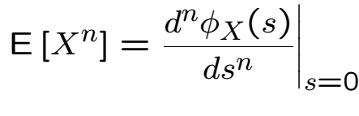
Generating Moments
The MGF of a RV $X$ is defined as
Easy to see that

Slide 4



MGF of a Sum of Independent RVs
Let $W=X_{1}+…+X_{n}$ with $X_{i}$independent
If also identically distributed
Useful to prove asymptotic results about sums of RVs (LLN, CLT)
Useful to prove distributions of sums of RVs

Slide 6
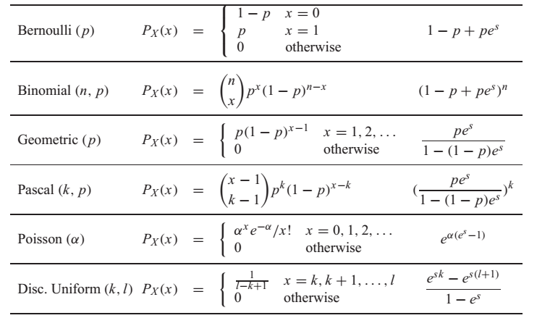
Discrete MGFs

Slide 8
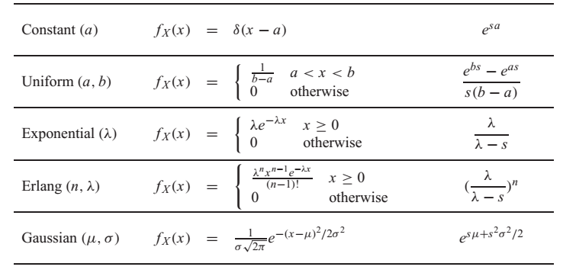
Continuous MGFs

Slide 10



Moment Finding Example
Find moments of exp. RV with parameter $λ$

Slide 11




Sum of Independent Poisson RVs
Let $W=K_{1}+…+K_{n}$ with $K_{i}$independent, Poisson with $E\left[K_{i}\right]=α_{i}$
Sum of independent Poisson RVs is a Poisson

Slide 12
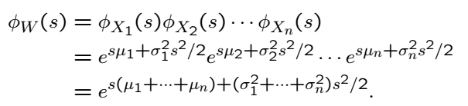
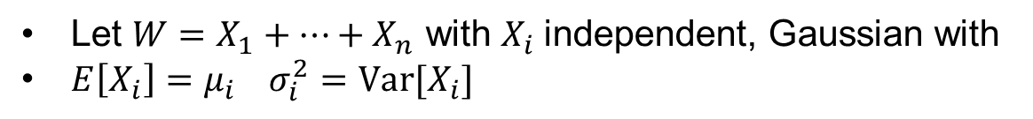
Sum of Independent Gaussian RVs
Let $W=X_{1}+…+X_{n}$ with $X_{i}$independent, Gaussian with
$E\left[X_{i}\right]=μ_{i} σ_{i}^{2}=Var[X_{i}]$
Sum of independent Gaussian RVs is a Gaussian

Slide 13
Acknowledgements and Citations
Parts of these slides are adapted from the following resources:
Power Point Lecture Slides for the Textbook http://bcs.wiley.com/hebcs/Books?action=index&bcsId=8676&itemId=1118324560
John Tsitsiklis. 6.041 Probabilistic Systems Analysis and Applied Probability, Fall 2010. (Massachusetts Institute of Technology: MIT OpenCourseWare),http://ocw.mit.edu (Accessed 13 Apr, 2015). License: Creative Commons BY-NC-SA

